Slide 1
An Improved Canny Edge Detection Algorithm^{[1]} W. Rong, Z. Li, W. Zhang, L. Sun
蔡炀 李澄曜 钱昱光
2017.6.1
Notes:
[1]Rong W, Li Z, Zhang W, et al. An improved CANNY edge detection algorithm[C]//Mechatronics and Automation (ICMA), 2014 IEEE International Conference on. IEEE, 2014: 577-582.

Slide 2
Contents
Background
Traditional Canny^{[2]}
Motivation
Related Works
The Improved Algorithm
Image Gradient Calculation
Adaptive Threshold Selection
Our Work
Algorithm Design
Experiment and Analysis
Strengths and Weaknesses
Future Work
References
Notes:
[2]Canny J. A computational approach to edge detection[J]. IEEE Transactions on pattern analysis and machine intelligence, 1986 (6): 679-698.

Slide 3
Background
Traditional Canny^{[2]}
Three Criteria
SNR criterion
Localization precision criterion
Single edge response criterion
Four Steps
Image filtering
Image gradient calculation
Non-maximum Suppression (NMS)
Checking and connecting edges
Notes:
As there has been already a detailed explanation in the course materials and PPT on the traditional Canny edge detection, here we just report a quite simple description.

Slide 4
Background
Problems in Traditional Canny
Adopting 2×2 neighboring area to calculate image’s gradient
- Easy to lose real edge information.
Fixed threshold
- Easy to lose local characteristic edge information.
Notes:
The first one is that the traditional algorithm adopts first order limited difference of 2×2 neighboring area to calculate image’s gradient. It’s simple for calculation, but it’s more sensitive to noise. Because of not join the deviation on the direction of 45°and 135°, it’s easy to lose real edge information.
The second one is that the double-threshold of the traditional Canny algorithm is set a fixed value. For images with rich edge information, the adaptability of traditional Canny algorithm isn’t ideal, and it’s easy to lose local characteristic edge information.
This paper introduced the concept of gravitational field intensity to replace the image gradient, and proposed two adaptive threshold selection methods for two kinds of typical images.

Slide 5
Background
Motivation
To improve the image gradient calculation operator, which is helpful to preserve more useful detail edges and more robust to noise.
Two adaptive threshold selection methods were presented for two kinds of typical images respectively, and it can contribute to fit diffident conditions automatically.
Notes:
Since the image quality will be influenced by some factors such as noise and illumination in the process of the image acquisition, what’s more, to the large view scope of images, its local contrast is different from each other, the parameters of the traditional Canny edge detection algorithm are fixed and cannot adapt to the edge detection process in different conditions. Therefore, this paper improved the image gradient calculation operator, which is helpful to preserve more useful detail edges and more robust to noise. Two adaptive threshold selection methods were presented for two kinds of typical images respectively, and it can contribute to fit diffident conditions automatically.

Slide 6
Related Works
Wang extended the 2×2 neighboring area to 3×3 neighboring area to calculate image gradient, using the Sobel operator to execute convolution^{[3]}.
Li used the Prewitt operator to accomplish convolution^{[4]}.
Notes:
Due to the introduction of the diagonal direction partial derivative, more edge information was preserved and the precision of edge location was improved. Experimental results demonstrate that an edge operator with a larger mask may provide a better edge detection result.
[3]X H Wang,Y J Qian. An improved Canny edge detection algorithm[C]//Mechanical and Electrical Engineering Magazine, 2008: vol.25,no.12,pp.60-63.
[4]Er-Sen L, Shu-Long Z, Bao-shan Z, et al. An adaptive edge-detection method based on the canny operator[C]//Environmental Science and Information Application Technology, 2009. ESIAT 2009. International Conference on. IEEE, 2009, 1: 465-469.

Slide 7
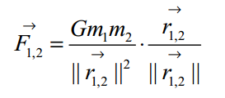

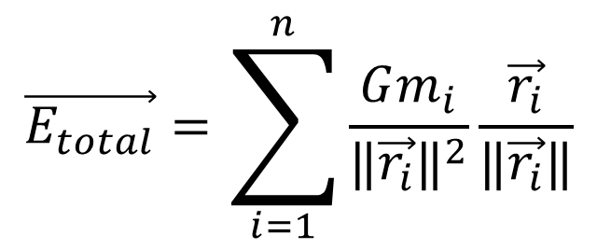
Image Gradient Calculation(1)
“Gravitational edge detection algorithm”
The law of universal gravity
The gravitational field intensity
Notes:
Formula 1: m1 and m2 are the masses of the bodies, G is the gravitational constant, r is the vector from body 1 points to body 2.
Formula 2: G stands for constant, m is the “mass” (gray value) of the pixel.
Formula 3: The total resulting field intensity assigned to a point can be calculated.

Slide 8


Image Gradient Calculation (2)
2×2 neighboring area operator
$$\vec{E_{x}}=\sqrt{2}G(m[i+1,j+1]−m[i,j+1]+m[i+1,j]−m[i,j])\vec{i}$$
$$\vec{E_{y}}=\sqrt{2}G(m[i+1,j+1]−m[i+1,j]+m[i,j+1]−m[i,j]) \vec{j}$$
y
m[i,j+1]
m[i+1,j+1]
o
x
m[i,j]
m[i+1,j]
Notes:
In practice, the G can be set to other value to act at some special circumstances. If let G= sqrt(2) / 2 , it can be seen that the gravitational field intensity calculation template is the same to the traditional Canny gradient calculate operator for the 2×2 neighbouring area.

Slide 9





Image Gradient Calculation (3)
3×3 neighboring area operator
I[i-1,j+1] m1 | I[i,j+1] m2 | I[i+1,j+1] m3
I[i-1,j] m8 | I[i,j] | I[i+1,j] m4
I[i-1,j-1] m7 | I[i,j-1] m6 | I[i+1,j-1] m5
$$G_{x}=\left(\begin{matrix}−\frac{\sqrt{2}}{4} & 0 & \frac{\sqrt{2}}{4} \\ −1 & 0 & 1 \\ −\frac{\sqrt{2}}{4} & 0 & \frac{\sqrt{2}}{4}\end{matrix}\right)$$
$$G_{y}=\left(\begin{matrix}\frac{\sqrt{2}}{4} & 1 & \frac{\sqrt{2}}{4} \\ 0 & 0 & 0 \\ −\frac{\sqrt{2}}{4} & −1 & −\frac{\sqrt{2}}{4}\end{matrix}\right)$$
Make G=1
Notes:
In order to retain more edge information, this paper extend the neighbouring area form 2×2 to 3×3 window. The table above shows the pixels' position of 3×3 window. After similar calcution, we make the constant G=1, and it's easy to obtain the 3×3 neighbouring area operator Gx and Gy.

Slide 10
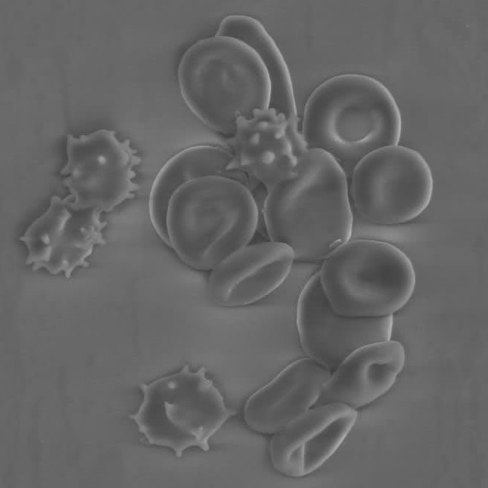

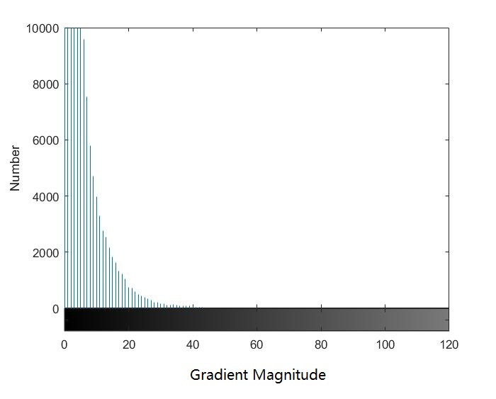
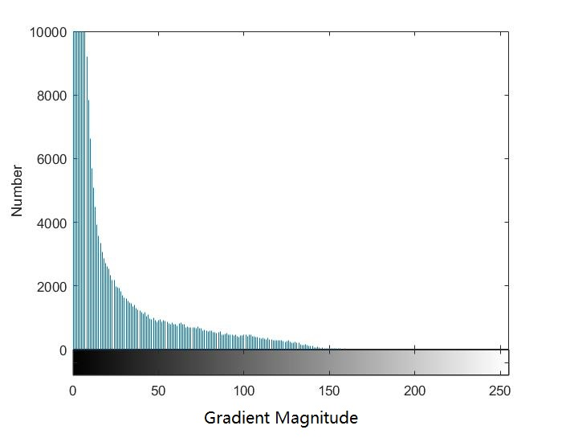
Adaptive Threshold Selection(1)
Two typical situations
(a) cell image (less edge information)
(b) cartoon image (rich edge information)
(c)(d) Gradient magnitude histogram for two typical images
Notes:
In practical engineering, there are two typical situations involving image edge detection:
(1) less edge information, mostly occurred in microscopic vision;
(2) a large field of view and rich edge information, in which the edge pixels occupy a relatively larger proportion and the local image contrast is inconsistent.
For these two typical images edge extraction, this paper proposes two adaptive threshold selection methods respectively. The selection of threshold has great relationship with the mean of gradient magnitude and standard deviation. The mean of gradient magnitude response the distribution center location of gradient magnitude, and the standard deviation reflects the discrete degree of gradient magnitude distribution.

Slide 11
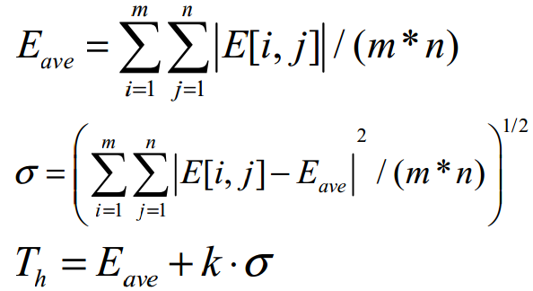
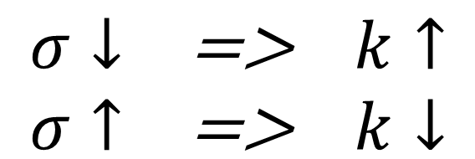


Adaptive Threshold Selection(2)
Method for image with less edge information
Notes:
The gradient magnitude of majority of the pixels is located in a small range in images with less edge information. The mean of gradient magnitude and the standard deviation of this kind of images is small relatively. Images in the field of micro-vision always have less edge information. The distribution of the gradient magnitude of those non-edge pixels is concentrated, therefore, a proper double-threshold can help select edge pixels out.
When image edge information is rich relatively and the gradient magnitude distribution is scattered, the value of σ will be larger, in order to keep more edge information the value of k should be smaller. Otherwise, the value of σ is smaller, and the value of k is bigger

Slide 12
Adaptive Threshold Selection(3)
Method for image with rich edge information
Steps of “Select a double-threshold for each pixel”:
Calculate E_{ave} and mark pixel smaller than 15-20% of E_{ave} as non-edge point.
Re-calculate E and σ of pixel I(i,j) in N×N matrix, whose center is I(i,j). (N is an odd number and larger than 20)
Calculate threshold as it is in the less edge condition.
Notes:
Selecting a double-threshold for the whole image can not help accomplish edge detection, since the selected threshold will be too high for some edge regions with small gradient magnitude, which will lead to the loss of detail edges. For this kind of images, this paper proposed a method to select a double-threshold for each pixel.
Step 1 contributes to guarantee that for image with large field of view and rich edge information, the improved algorithm won’t introduce more noise in areas where there are few edges, that is, the mean of gradient magnitude and standard deviation of these areas are very small.
Step 2 When the pixel I [i,j] is located in the border area of the image and the matrix is less than N×N, the insufficient parts were set null, then calculate the mean and standard deviation of this matrix to obtain the threshold.

Slide 13
Algorithm Design
Gaussian Filtering
Gradient Calculation
Threshold Calculation
Edge Connecting
Non-Maximum Suppression
Gradient calculation is realized by a 3×3 operator.
For image with less edge information, the threshold is obtained by calculating the average and standard deviation of the total image gradient.
For image with less edge information, the threshold of an exact pixel is determined by the average and standard deviation of its surrounding N×N block’s gradient.
Notes:
According to the paper[1], we use MATLAB to test the performance of the improved Canny algorithm with the code programmed by ourselves and carried out the research experiments on the cell image, liftingbody image and tire image which are 256-level gray, using the traditional Canny edge detection algorithm and the improved algorithm respectively.

Slide 14
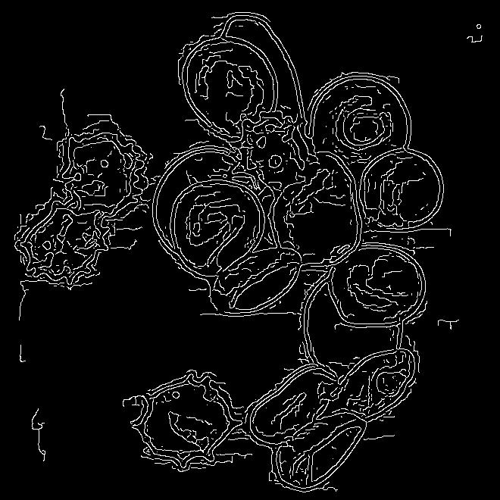
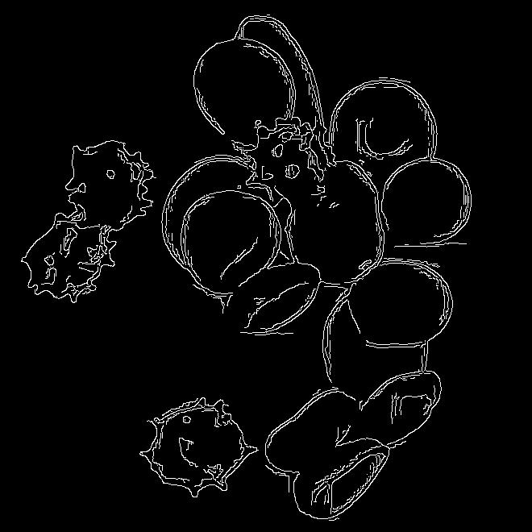
Experiment and Analysis(1)
Experiment for cell image
(a) traditional method
(b) method for images with less edges in this paper, k=1.6
Notes:
The cell image is mentioned in two typical situations of Adaptive Threshold Selection(1).
Since the cell image which is in the microscopic view has a little of edge information, the mean of gradient magnitude and standard deviation are small, k was made to be 1.6 , and selecting a double-threshold for the whole image is practicable to achieve the goal of edge detection.
It can be seen from (a) that the traditional Canny algorithm is sensitive to noisy. (b) shows the detection result of the improved method (both two algorithm). Compared with traditional method, the improved algorithm presented is more robust to noise and it can preserve more useful edge information. The improved algorithm has a better edge detection result than the traditional Canny algorithm, so it's more competitive. The improved algorithm has great practical value in microscopic visual edge detection engineering.

Slide 15
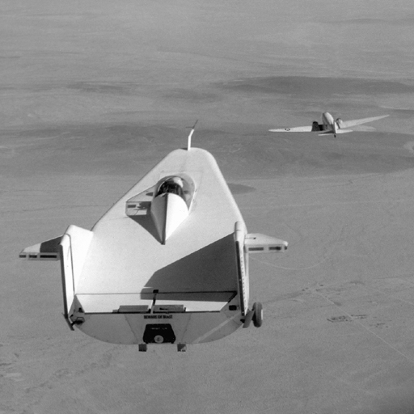
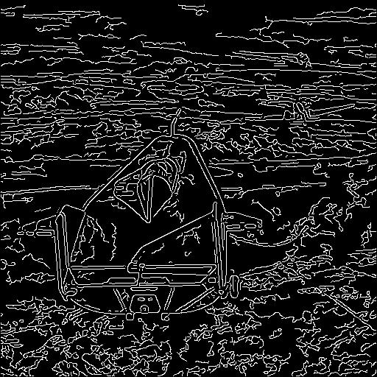
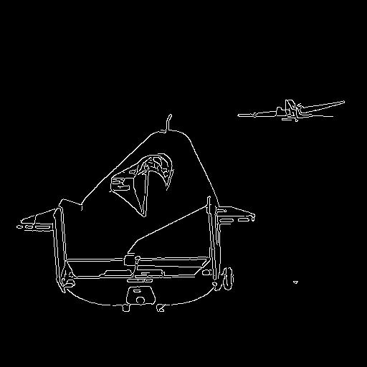
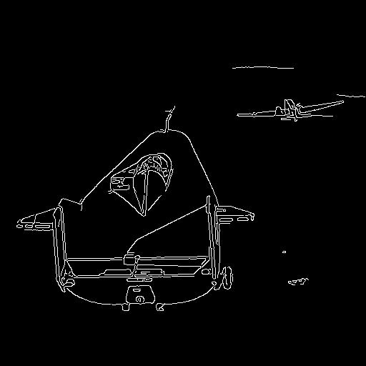
Experiment and Analysis(2)
Experiment for liftingbody image
(a) liftingbody image
(b) traditional method
(c) method for images with less edges, k=1.6
(d) method for images with less edges, k=1.2
Notes:
In some particular situations, although images have a large field of view, the mean of gradient magnitude and the standard deviation of the whole image are small. For this kind of image, this paper used the method for images with less edges to detect edge information. These images shows the edge detection results of the liftingbody image. Compared with traditional Canny algorithm, the improved method is more robust to noise, and it has higher SNR. Also, the difference between (c) and (d) is that in former image the value of k is 1.6,and the latter k is 1.2. Since the standard deviation of this kind of images is large relatively, so when k is small, it can preserve more edge information. However, if k is too small, it will be sensitive to noise and easy to bring in fake edges.

Slide 16
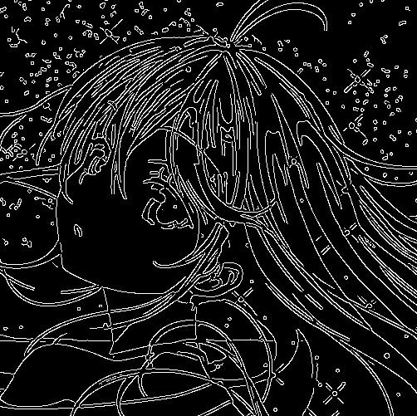
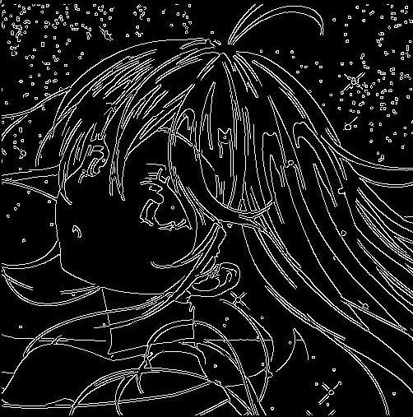
Experiment and Analysis(3)
Experiment for cartoon image
(a) traditional method
(b) method for images with rich edges, 51×51 neighboring area, k=1.2
Notes:
The cartoon image is mentioned in two typical situations of Adaptive Threshold Selection(1).
The result of traditional Canny algorithm is shown (a). And (b) shows the edge detection results of the improved algorithm for images with rich edge information, in which every pixel has its own double-threshold, and N=51, k=1.2. Compared with traditional Canny algorithm, the method in this paper for this kind of image can show the main part more clearly and preserve more local edge information in some areas.
Actually, we tried the proposed method for image with rich edge information. However some unexpected results occurred. When the window length N is small, more edges appear which we do not need. We observed the calculated threshold and discovered it much smaller than expected values. We analyzed the result and proposed a possible explanation. The average gradient is smaller in a small window where gray level is close than that of the total image. Thus according to the threshold formula both high and low thresholds are relatively small in such area, resulting in unexpected edges. Taking it into consideration , we set N a lot larger and obtained a better result. Nevertheless when the N is as large as the size of the image the result is the same as the method for less edges.

Slide 17
Strengths and Weaknesses(1)
Strengths:
Keep the advantages of the traditional Canny algorithm.
This algorithm can obtain threshold automatically.
Enhance the ability of noise suppression and keeps more edge information, i.e. it has higher SNR.

Slide 18
Strengths and Weaknesses(2)
Weaknesses:
Computing speed is relatively slow.
The improvement is not remarkable enough. Especially when we tried the proposed method for image with rich edge information, we find more useless edges appear when the window length N is small. Although we has tried to improve it according to the remarks in Experiment and Analysis(3), the results need to be improved.

Slide 19
Future Work
Improve computing speed by optimization of code.
Try to find better operator’s order (now 3×3 can be changed into N×N or M×N ).
Try to optimize the calculation of threshold further.
Establish a rule to distinguish the specific type of images.

Slide 20
References
[1]Rong W, Li Z, Zhang W, et al. An improved CANNY edge detection algorithm[C]//Mechatronics and Automation (ICMA), 2014 IEEE International Conference on. IEEE, 2014: 577-582.
[2]Canny J. A computational approach to edge detection[J]. IEEE Transactions on pattern analysis and machine intelligence, 1986 (6): 679-698.
[3]X H Wang,Y J Qian. An improved Canny edge detection algorithm[C]//Mechanical and Electrical Engineering Magazine, 2008: vol.25,no.12,pp.60-63.
[4]Er-Sen L, Shu-Long Z, Bao-shan Z, et al. An adaptive edge-detection method based on the canny operator[C]//Environmental Science and Information Application Technology, 2009. ESIAT 2009. International Conference on. IEEE, 2009, 1: 465-469.

Slide 21
THANKS!

